Slide 1
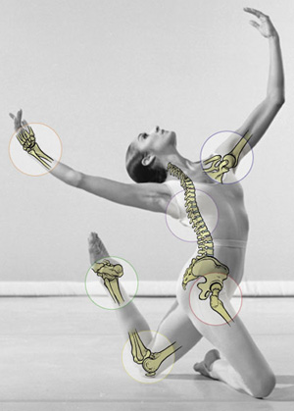
Dancing Smart
Injury Prevention

Slide 2
Can you really get hurt dancing?
So You Think You Can Dance

Slide 3
Different kinds of injuries
Acute Injuries- “out of the blue” or sudden
Chronic- from repetitive stress over time
***For the most part, an injury occurs when a part of your body is weak and/or when you are tired physically or psychologically or both.

Slide 4
Causes of Injury
Ignoring misalignment/ improper placement
Overuse of muscles
Dancing on hard surfaces
Heat exhaustion
Poor health habits (unbalanced eating habits, lack of sleep, or use of drugs)
Performing a combination that is beyond your ability
Ignoring one’s own fatigue warning signs
Over/Under body weight
Dancing under high levels of emotional or psychological stress
Dancing without proper warm-up

Slide 5
Anatomy that matters…
Muscles: elastic tissue which moves our limbs and joints and provides padding for our organs.
Tendons: Tough tissue that connects muscle to bone
Ligaments: Tough tissue that connects bone to bone

Slide 6
Basic Dance Injuries
Cramps
Cramps occur because muscles are overly tired
Relieve a cramp by gentle stretching and massage
Soreness can result from a cramp
To help avoid cramps, drink plenty of water and warm-up properly
For dancers, cramps usually occur in the arch of the foot or the calf of the leg.

Slide 7
Basic Dance Injuries
Muscle Soreness
Acute soreness often results from a strenuous dance class after a period of inactivity. You may come away from the class feeling soreness in your legs or upper body from what you have done in the class.
Delayed soreness is soreness that occurs 24 to 48 hours after a dance class. This soreness can be severe and can last two to three days after exercise.
In order to prevent soreness, one must properly warm-up, stretch, and then cool-down.

Slide 8
Basic Dance Injuries
Sprain
Joint goes beyond its normal range of motion and involves the tearing of the ligaments.
Sprains occur from misalignment of the body
Ankle sprains are the most common type of sprain for dancers.
To avoid ankle sprains, it is important that the ankle be centered under the knee at all times, especially when landing from a jump or leap.

Slide 9
Basic Dance Injuries
Strain
A strain is the tearing of the muscle and sometimes the tendons.
Common causes can be the result of excessive force, structural weakness, overuse, and incorrect execution of an exercise.
More than likely, strains occur in dancers due to an improper warm-up or a lack of flexibility.
Use the RICE recovery method.

Slide 10
Basic Dance Injuries
Shin Splints
Shin splints are a minor tearing of the muscle attachments from the tibia (shin bone)
Icing and resting the shins help with minimizing the pain.
Extreme severity of this syndrome can lead to stress fracture in the tibia.

Slide 11
Basic Dance Injuries
Knee Injuries
Knee injuries are almost always triggered by persistent pain, redness, or swelling in the region of the knee.
Twisting your knees for a better turnout position will put you at risk for knee damage.
An orthopedic physician should be consulted immediately.
Back Injuries
Back pain most common in dancers is caused by muscle strain, accentuated by rotary or bending movements of the back.
A warm bath can help soothe the pain because of the antigravity effect of the water.

Slide 12
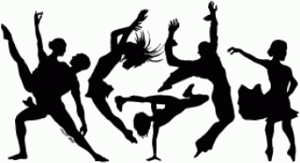
***MOST INJURIES IN DANCERS OCCUR FROM THE LOWER BACK DOWN***

Slide 13
Can your body “talk” to you?
Yes!!!!
The dancer who is attuned to his or her body knows that a movement once easily accomplished and now presenting difficulty indicates something wrong.
*** ALWAYS LISTEN TO YOUR BODY !!! THEN, TREAT YOUR INJURY APPROPRAITELY***
A serious injury demands immediate attention: it is either too painful, swollen, tender, or stiff to be denied. It is the dancer’s responsibility to recognize and protect the area as soon as the injury occurs.
***LISTEN TO YOUR BODY, AND CONSULT A DOCTOR***

Slide 14
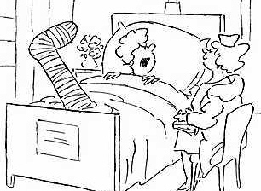
R I C E
1) Rest- Rest…you should get off the injured area and build back slowly.
2) Ice- Minimize the swelling. Ice the area until it is numb (about 10-15 minutes). Passively move the joint through its current range of motion. Repeat every 30 min – 1 hr until the swelling subsides. There are several methods to do this.
3) Compression- There are several methods of wrapping and padding, watch individually helpful to the specific injured area.
4) Elevation- It is important that you elevate the injured area above the level of the heart.

Slide 15
R I C E
RICE

Slide 16
How do you prevent injuries?
Proper conditioning is vital for the dancer. In order for anyone to efficiently execute a motor task, there must be adequate STRENGTH, FLEXIBILITY, and ENDURANCE. Good Posture and ALIGNMENT are also necessary for the maximum functioning of the body with the exertion of the least amount of energy.

Slide 17
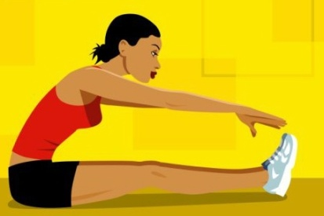
How do you prevent injuries?
Strength: the capacity of the individual to exert a muscle contraction or force against a resistance.
Flexibility: the extent to which a limb can be extended and flexed; also, increasing the range of movement in a joint.
Endurance: the staying power of the body, divided into two components; muscular and cardiovascular.
Muscular: the ability to sustain many muscle contractions over a given period of time.
Cardiovascular: the ability to effectively deliver oxygen to the muscle tissue or a long period of time.
Alignment: appropriate positioning of the body parts for the best movement efficiency.
Nutrition: because of the demands the dancer places on his or her body, individuals must pay attention to ingesting a healthy, well-balanced diet, which included plenty of water.

Slide 18
Top Ten Prevention Tips for Dancers
1. Proper training and teaching are essential to allow dancers of all ages to develop their
skills without injury.
2. Take adequate rest to allow the body to heal itself from daily wear and tear.
3. Maintain energy levels by eating and drinking adequately.
4. Conditioning and strengthening of the leg muscles that support the arch are crucial.
5. Try to avoid dancing on hard or uneven surfaces, which could cause injury.
6. Take care of your shoes!
7. Dancers should adopt new training schedules slowly.
8. Although not always possible when dancing, but more so off stage or out of class, wear
supportive footwear, and if you need to wear orthotics, wear them as often as possible.
9. If dancers perform excessive pointe or demi-pointe work one day, they should focus on
other types of work during the next workout.
10. Early recognition of symptoms is important. Stop activity if pain or swelling occurs. If
the pain persists after a few days rest, consult a sports-medicine physician.

Slide 19
If you take care of your body, you will be able to…
Dance !!!

Slide 20
Injury Prevention Review
Common Sense Information I Already Know
New Information or Information That is Difficult for Me to Remember

